Slide 1
BRAND EQUITY
DEMOGRAPHIC VARIABLES
(Region, Gender, Age, Children, Income)
02
01
MEASURING DIMENSIONS
(Loyal, Popularity, Familiarity, Uniqueness, Relative)

Slide 2
1) Run a crosstabs using the variables BRAND and LOYALBIN. What do the results tell you?

Slide 3
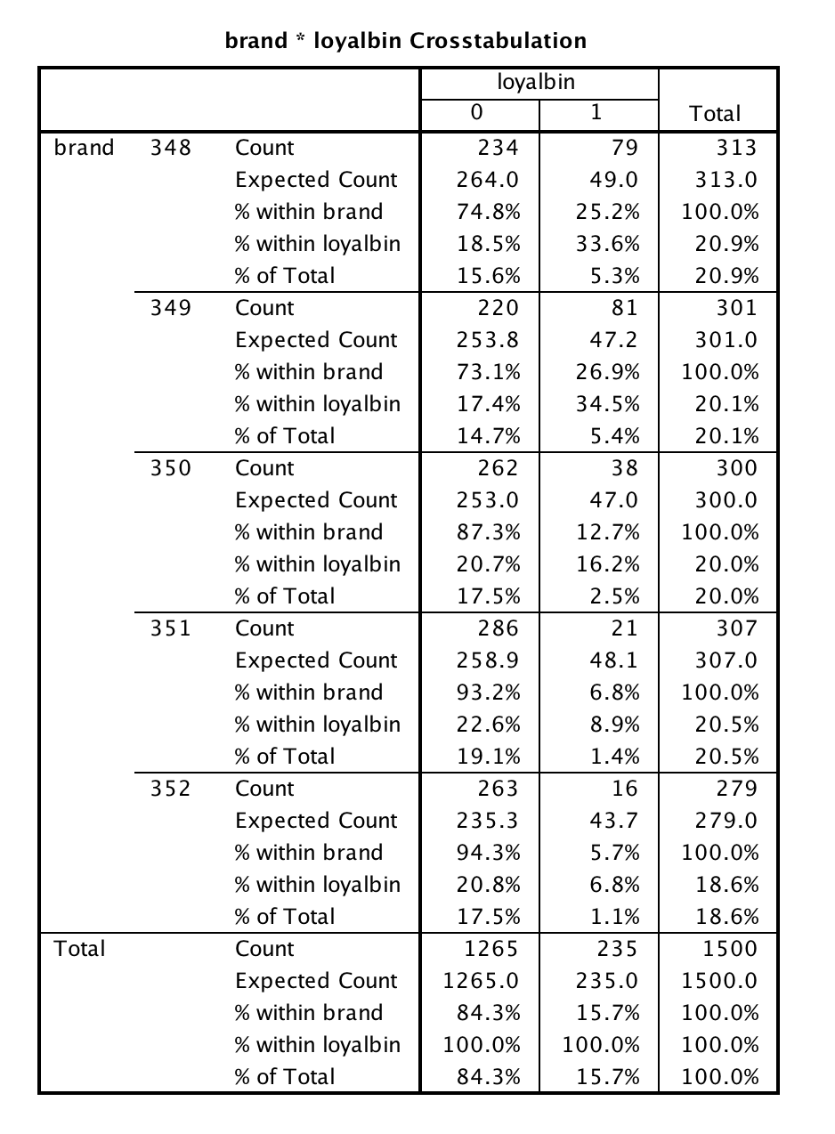
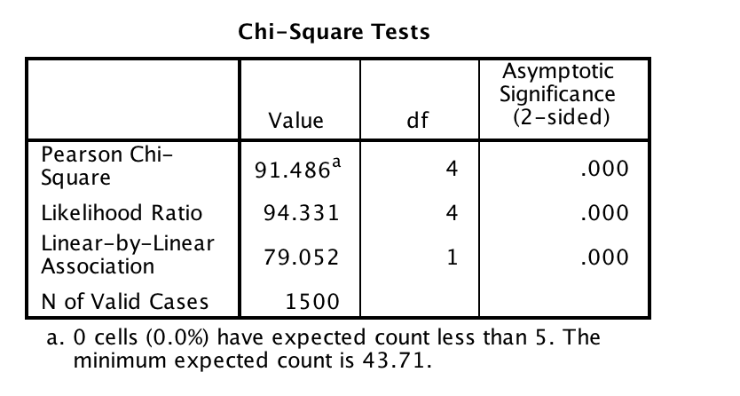
H0: Loyalty is independent of brand.
H1: Loyalty is dependent of brand.
At Confidence interval of 95%
Value : 91.486
Degree of Freedom: 4
The P-Value is < 0.00001.
The result is significant at p < 0.05.
Reject the NULL Hypothesiss

Slide 4
2) Delete the brands associated with UK and AirUSA. Rerun the crosstabs. What do the results tell you?

Slide 5
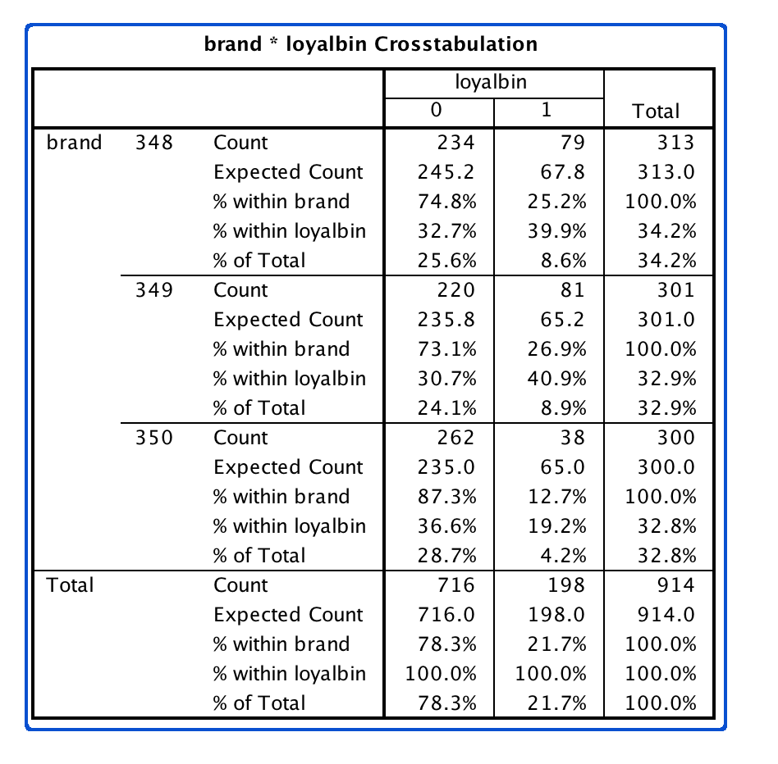
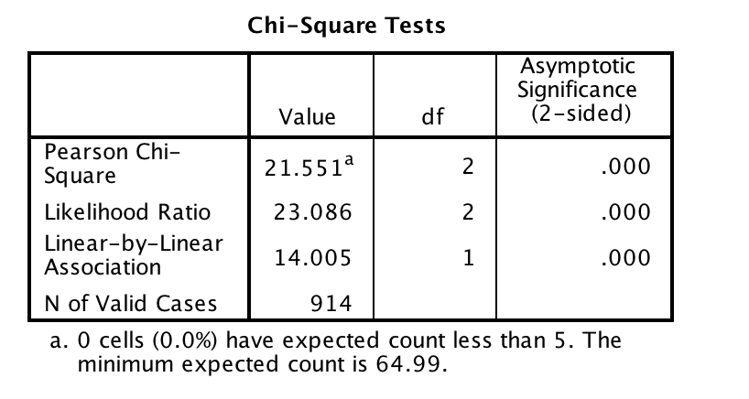
H0: Loyalty is independent of brand.
H1: Loyalty is dependent of brand.
At Confidence interval of 95%
Value : 21.551
Degree of Freedom: 2
The P-Value is 2.1E-05.
The result is significant at p < 0.05.
Reject the NULL Hypothesiss

Slide 6
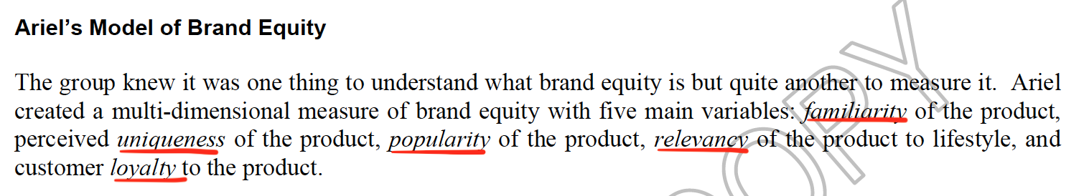
3) How can you measure brand equity with the collected data?

Slide 7
Brand Equity
Loyalty
Relevance
Familiarity
Popularity
Uniqueness
We can measure brand equity using the average (mean score) of the 5 measurements: loyalty, relevance, familiarity, uniqueness and popularity.

Slide 8
4) What statistical analysis is suitable to compare brand equity across brands? Why? Compare brand equity across brands for your chosen category.

Slide 9
One-way ANOVA. (Analysis of variance).

Slide 10
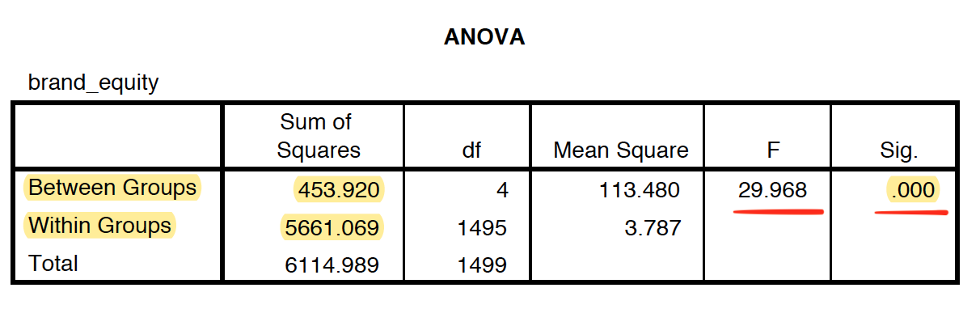
H₀ → All the brands have the same brand equities.
H_{a} → At least one brand has a significantly different brand equity.
The F-Test shows that there is significant difference in the means.
We conduct Post-Hoc Test.
We chose Scheffe because the samples have different populations.

Slide 11
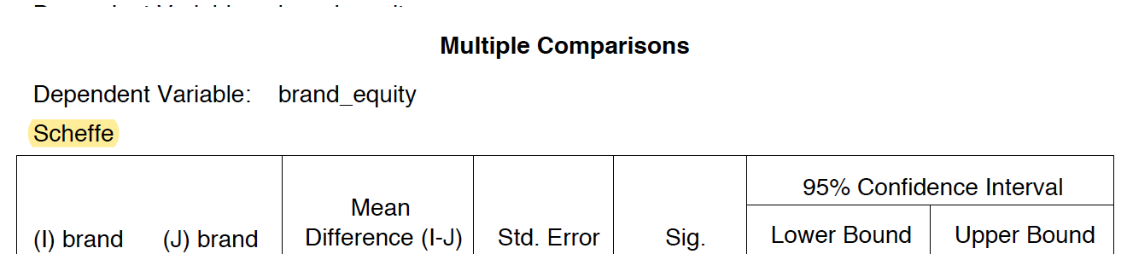
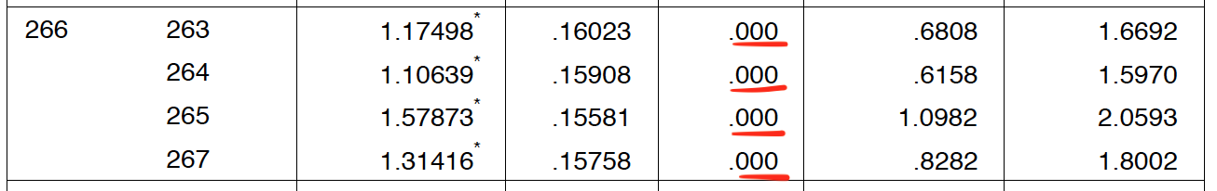
The brand equity of 266 is significantly different than all
the others brands.

Slide 12
5) Compare loyalty, relevance, familiarity, uniqueness and popularity for the brands of your chosen category using the appropriate statistical analysis.

Slide 13
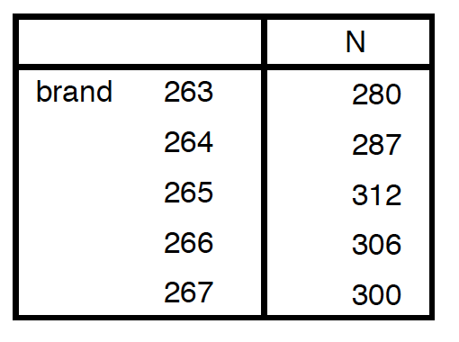
MANOVA test (2 or more dependent variables).
H₀ → No differences between loyalty, relevance, familiarity, uniqueness and popularity among different brands.
H_{a} → Differences exists between loyalty, relevance, familiarity, uniqueness and popularity among different brands.

Slide 14
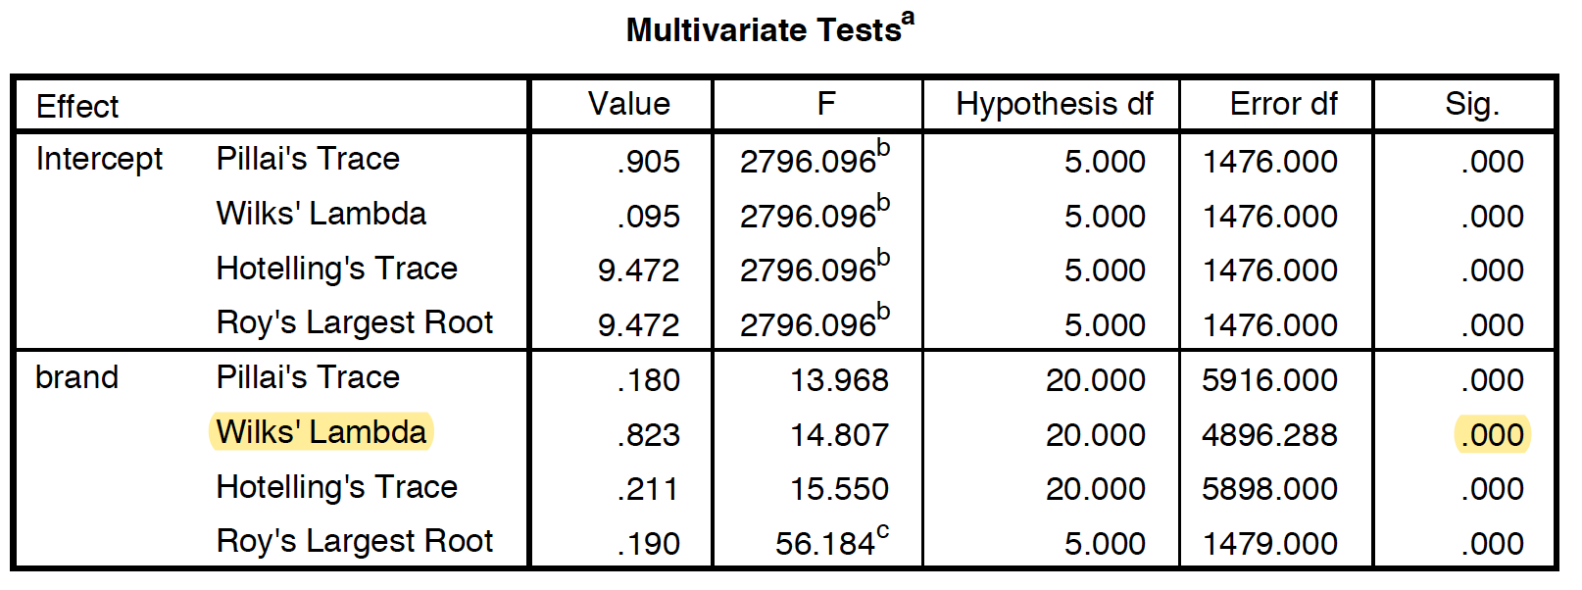
There is significant difference between at least one variable.
We must test individual ANOVAs.

Slide 15

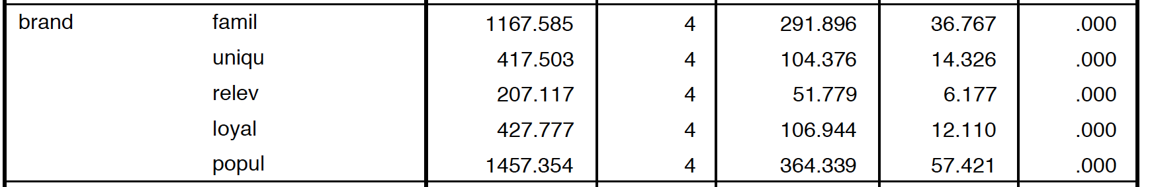
Individual ANOVAs
There is significant difference.
We conduct Post-Hoc (Tukey).

